Slide 1


ML.NET in the Real World

Slide 2


Who am I?
Dinesh Kumar P
Product Manager - Analytics
Notes:
Product Manager for the Reports & Analytics squad.

Slide 3
What is Machine Learning?
Artificial Intelligence
Machine Learning
Getting computers to make predictions without being explicitly programmed
Artificial Intelligence
The ability of a computer to perform tasks commonly associated with intelligent beings (reason, discover meaning, generalize, learn from past experience)
Deep Learning
Subset of ML based on artificial neural networks which imitate the way the human brain learns, thinks, and processes data.
Machine Learning
Deep
Learning
Notes:
AI = machines imitating human abilities and behaviors
Typically starts as rule or logic-based system
Traditional AI techniques can be difficult to scale
ML
Computers find patterns in data and learn from experience to act on new data
Used to solve problems that are difficult or impossible to solve with rules-based programming
Deep learning
Neural networks form many layers
Scenarios include image classification, object detection, speech recognition, NLP
AI: Rules + Data = Answers
Data + Answers = Rules

Slide 4









Machine Learning Landscape
External
At Microsoft
Azure Cognitive Services
Azure Machine Learning
WinML
 | Training custom models | Model consumption | Requires ML knowledge
ML.NET | Yes | Yes - ML.NET, TensorFlow, ONNX | No
Azure Cognitive Services | Limited to some services | Yes – consume via API/SDK | No
Azure ML | Yes | Yes – register models & consume via web service | Somewhat
WinML | No | Yes - ONNX | No
Notes:
scikit-learn – Traditional / Classical Machine Learning
TensorFlow – ML Deep Learning
PyTorch – ML Deep Learning
Keras – Open-source library that provides a Python interface for artificial neural networks. Higher level API for building ML that can use a variety of back-ends to actually build the models and computations; Keras acts as an interface for the TensorFlow library.
ONNX - An open format built to represent machine learning models allowing you to interchange models between various ML frameworks and tools. AI developers use models with a variety of frameworks, tools, runtimes, and compilers.

Slide 5

What is ML.NET?
An open source and cross-platform machine learning framework for .NET
Windows
Linux
macOS
Notes:
History:
2002: MSR begins TMSN (“text mining search and navigation”) to enable internal devs to easily add custom ML to Microsoft products and technologies
2011: Library renamed to The Learning Code (TLC); widely used within Microsoft
2018: TLC is made open source, cross-platform, and released as ML.NET in first public preview at Build 2018
2019: ML.NET GA release at Build 2019
2020: Virtual ML.NET – first all ML.NET conference!

Slide 6
Machine Learning for Developers
Rules
Classical Programming
Answers
Data
Data
Machine Learning
Answers
Rules

Slide 7


Artificial Intelligence
if(profileImage) {
if(isRectangular) {
if(topIsRound) {
if(hasEars) {
return false;
}
else if (hasEyes) {
return false;
}
else {
return true;
}
}
}
}
Bread
or
not bread?
Insert a bunch of if-else statements here to show that not scalable – insert MACHINE LEARNING

Slide 8
Machine Learning
Machine Learning
Getting computers to make predictions without being explicitly programmed
Computers find patterns in data and learn from experience to act on new data
Used to solve problems that are difficult or impossible to solve with rules-based programming

Slide 9

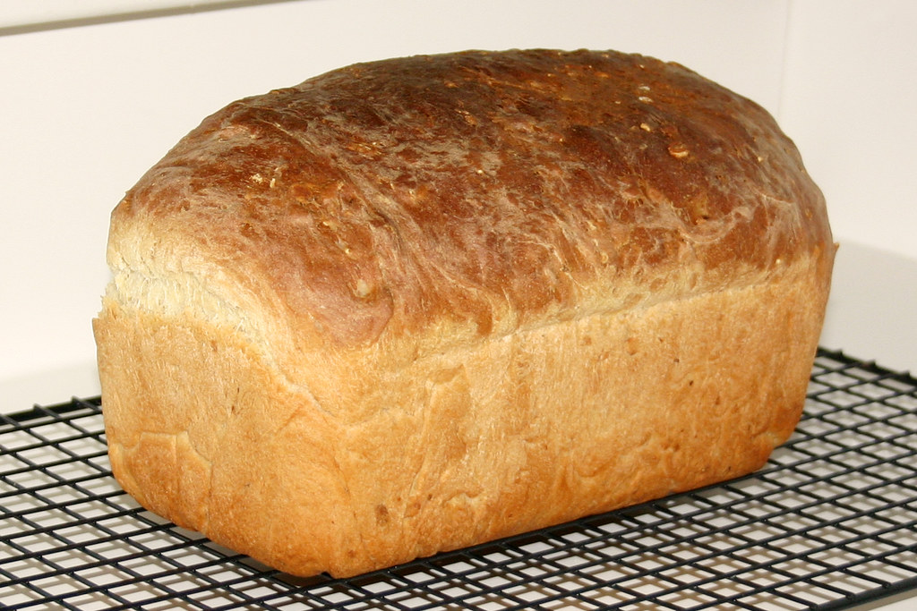
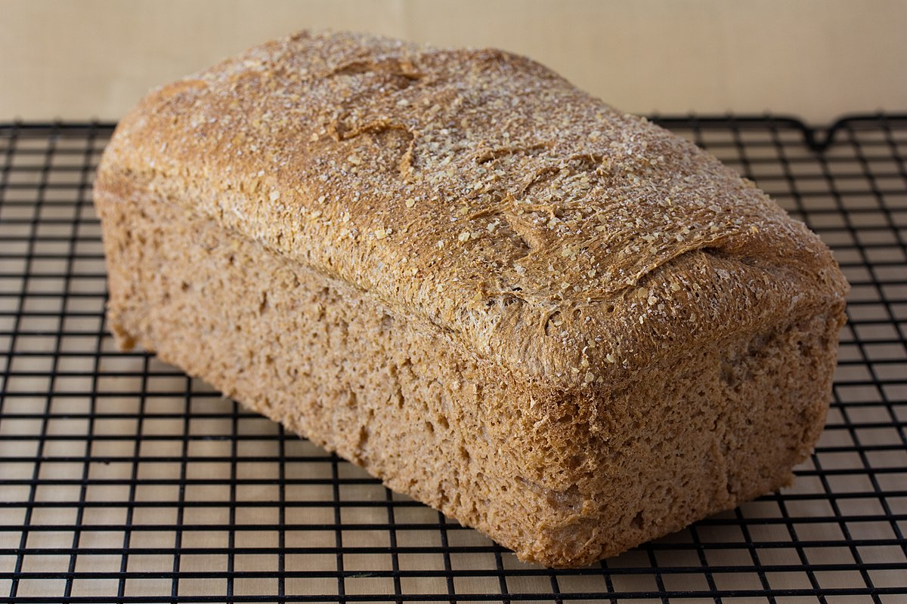
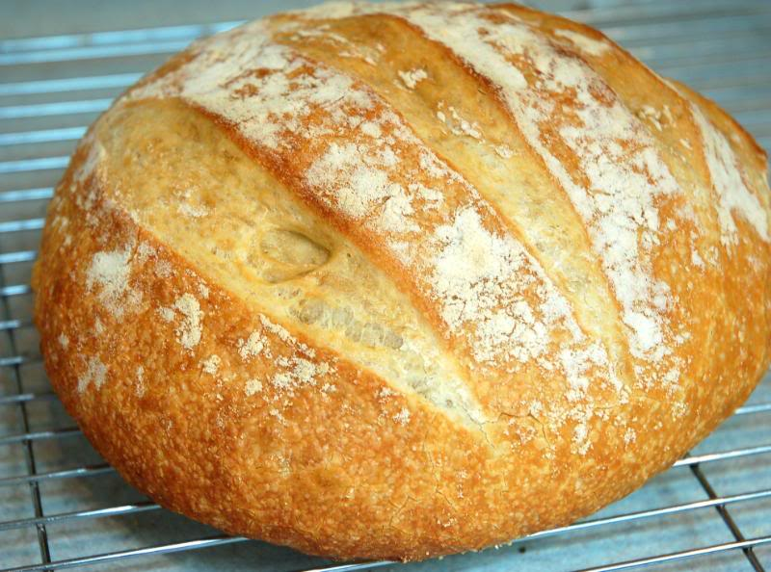








Machine Learning
Bread
Bread
or
not bread?
Not bread

Slide 10
Built for
.NET
Developers
Can use existing C# and F# skills to integrate ML into .NET apps
Data science & ML experience not required

Slide 11

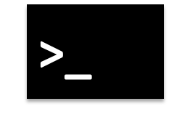
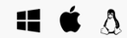


ML.NET + AutoML + Tooling
Model Builder
ML.NET CLI
AutoML.NET API
(Microsoft.ML.AutoML)
ML.NET API
(Microsoft.ML)

Slide 12
Mapping business problems to ML Tasks
What problem are you looking to solve?
Find outliers
Predict a number
Find relationships
Categorize items
Anomaly detection
Regression
Forecasting
Clustering
Binary classification
Multiclass classification
Make suggestions
Recommendation
Image classification
Phase 1.0
Notes:
Classification:
Categorize e-mail as spam or not spam
Automatically add labels to GitHub issues
Predict of sentiment of a comment is positive or negative
Diagnose if a patient has a disease or not
Categorize hotel reviews into location, price, cleanliness, etc.
Regression
Predict the price of a house based on house features
Predict sales of a product based on advertising budgets
Predict number of goals a player will scare in upcoming match based on previous perf
Recommendation
Recommend products to shoppers
Recommends movies or songs to users
Forecasting
Predict future sales based on past sales
Predictive maintenance
Weather forecasting
Product demand forecasting
Anomaly detection
Identify fraudulent transactions
Alert when there are predicted network intrusions
Find abnormal cluster of patients
Clustering
Customer segmentation
Ranking
Search results ranking

Slide 13
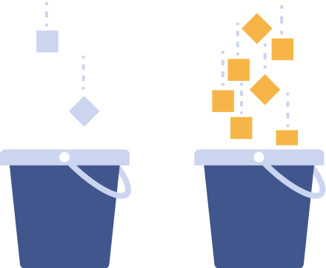
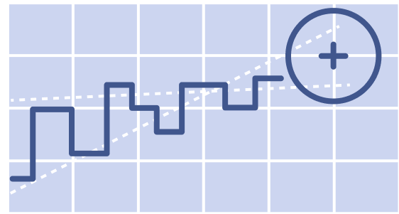

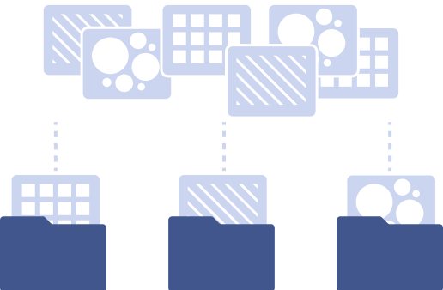





What can you do with ML.NET?
Classification
Regression
Forecasting
Anomaly detection
Image classification
Ranking
Clustering
Recommendation
Object detection
Notes:
Classification – Sentiment analysis, Categorizing e-mail as spam or not spam, Classify law documents
Regression – Price prediction, Predict sales of product based on advertising budgets
Forecasting - Predicting future sales based on past sales, Predictive maintenance, Weather forecasting
Anomaly detection – Identifying potentially fraudulent transactions, detecting network intrusions
Ranking – Search results ranking
Clustering – Customer segmentation
Recommendation – Product Recommendation

Slide 14
When should you use ML.NET?
When you…
Want to consume a pre-trained model (TensorFlow / ONNX).
Want to stay in .NET ecosystem for Machine Learning instead of Polyglot Programming.
Notes:
Polyglot programming is the practice of writing code in multiple languages to capture additional functionality and efficiency not available in a single language.

Slide 15
When should you use ML.NET?
When you…
Don’t want to worry about low-level complexities of ML.
Want to train a custom model.

Slide 16
Real world?
Already powering Microsoft products.

Slide 17
Why should I use ML.Net?
Works offline.
Speed up the experimentation process using AutoML.
Visual Studio users – Model Builder.
Linux / Mac users – ML.Net CLI.
3.
Notes:
1. MS machine learning SDK that works offline.

Slide 18
Roadmap
Dec 2020
Early 2021
All Azure-supported scenarios in Model Builder
Local forecasting, anomaly detection, object detection in Model Builder
Re-open state in Model Builder
Open-source tooling
Ongoing
MLOps Integration
Model explainability
Adding all ML.NET scenarios to tooling – local + Azure
ML.NET runs everywhere .NET runs, including Blazor WASM, mobile, IoT

Slide 19
Resources
Get started at http://dot.net/ml
Try the samples at http://aka.ms/mlnetsamples
Read the docs at http://aka.ms/mlnetdocs
Watch ML.NET videos at https://aka.ms/mlnetyoutube
Request features or contribute at http://aka.ms/mlnet
Take the workshop at http://aka.ms/mlnet-workshop

Slide 20
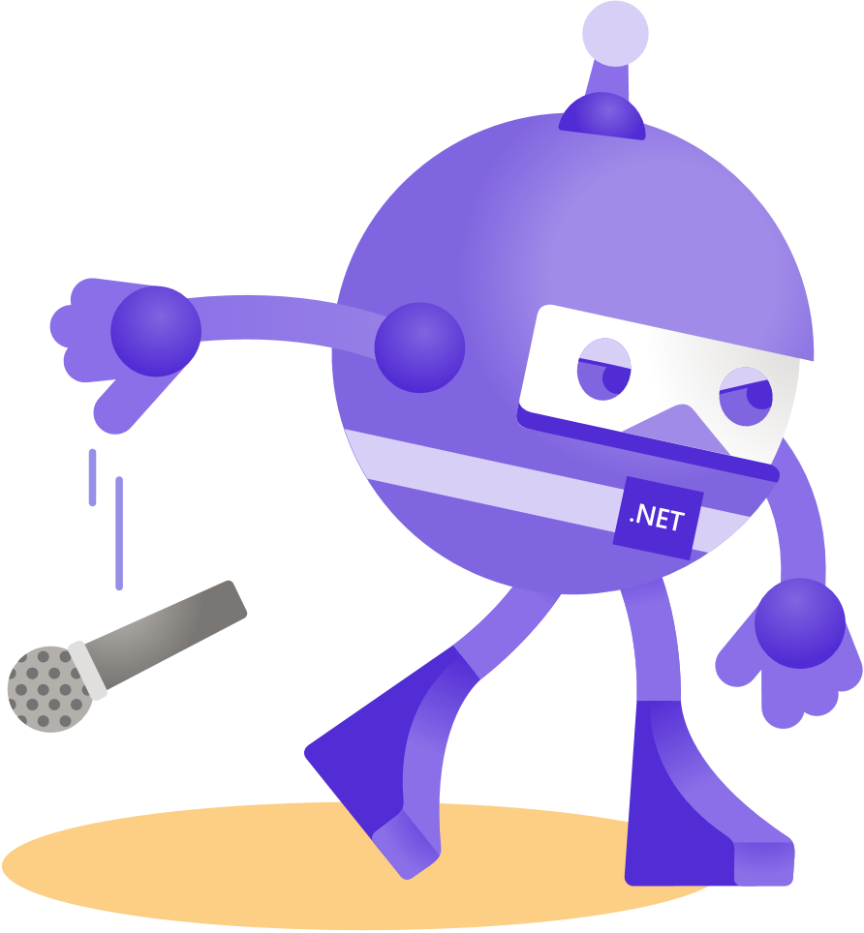
Thanks for joining!
LinkedIn - dinesh-kumar-prabakaran

